Slide 1
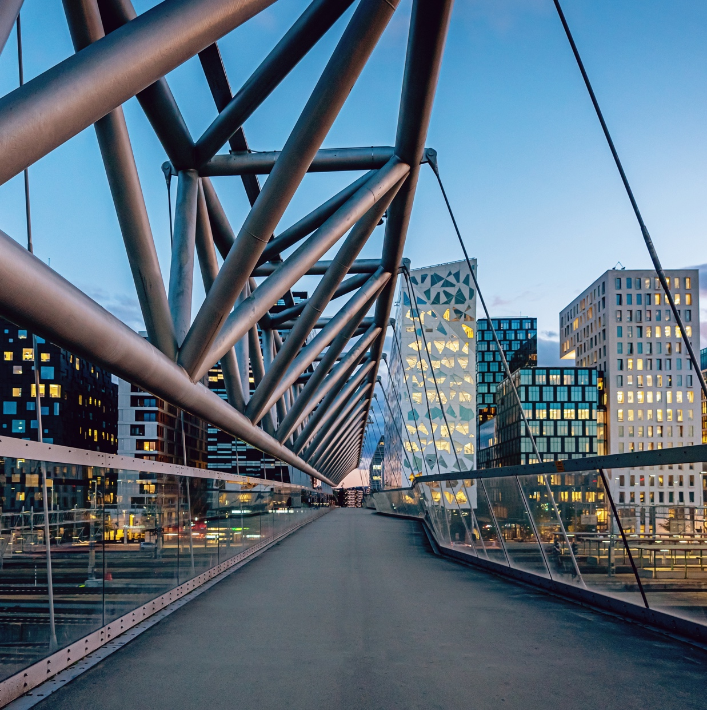
IHEEM Branch Update - October 24
Notes:
Key Messages:
Purpose:
To share our early work to establish a systematic process to allow the efficient and effective development of PFI guidance
To gain your feedback and insights on processes, plans and priorities
To understand any sector specific issues or matters that we may need to consider
To allow you to highlight best practice examples that may help inform our development of guidance
To discuss how you would like to be engaged in and support the development of guidance

Slide 2
IPA - Contacts
Transformation & Programmes incl New Hospital Programme and DHSC Link
Marc Stone - Marc.stone@ipa.gov.uk
PFI Centre of Excellence
Nick Iliff- Nick.iliff1@ipa.gov.uk
Steve Lawley - Steve.lawley@ipa.gov.uk
General Enquiries - pfi-operations@ipa.gov.uk

Slide 3
IPA - What we do
The Infrastructure and Projects Authority (IPA) is the United Kingdom government's centre of expertise for the delivery of large and complex physical, security, digital and services infrastructure, transformation, PFI and major projects. The IPA sits at the heart of government, reporting to the Cabinet Office and HM Treasury.
Please find our website link:
IPA - What we do

Slide 4
IPA (PFI) - What we do
The Programme comprises four projects:
Contract Expiry - managing the risks of contract expiry and ensuring value for money as contracts end
Improving Operational Performance - driving improved operational performance and better approaches to contract management across the PFI portfolio.
Building Capability - building capability through systems learning, guidance and training
Advice & Support - providing expert support and advice to departments and contracting authorities
Please find our website link:
PFI Centre of Excellence

Slide 5
Infrastructure and major programmes
What we do
We support government departments to improve their National services, infrastructure and assets via the 250 largest and most complex programmes across government.Providing expert advice on the delivery of:
Digital and services infrastructure
Defence and security
Built environment
Physical assets and infrastructure
Transport
Clean energy & net zero
Regeneration and places
Please find our website link: Infrastructure and major programme delivery

